Slide 1
Lucerne University of Applied Sciences and Arts
Master of Advanced Studies in Information Security
Methodology to select Security Information and Event Management (SIEM) Use Cases

Slide 2

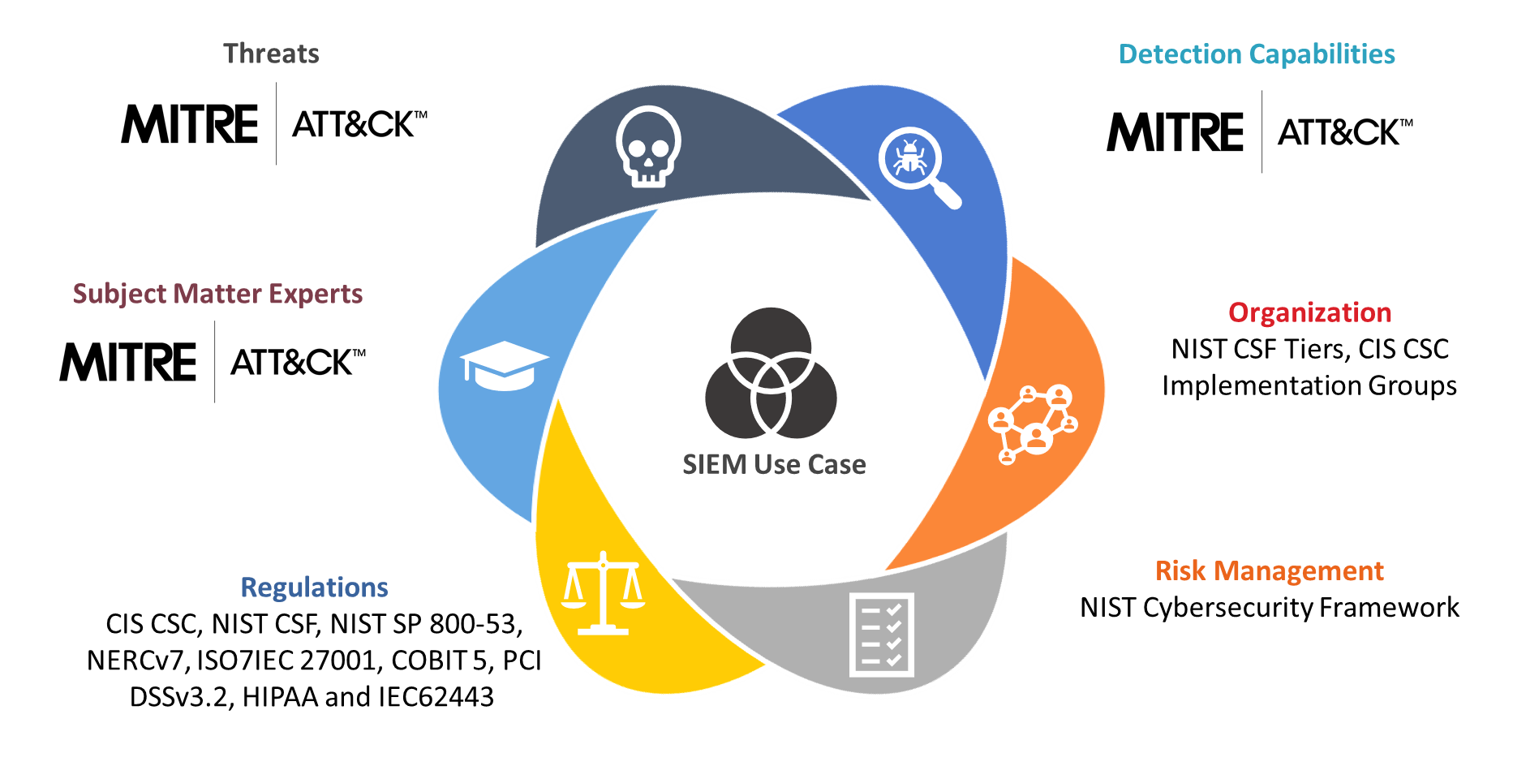
Speaker Introduction: Pascal Imthurn
Head Cyber Defense Services
20 years of experience in IT Sec
Milestones:
ISPIN: Developed & managed Cyber Defense Services
Open Systems: Security Architect
UBS: Global Head of SOC
Various: Linux firewall developer, reverse engineer, threat analyst
Public Link: www.siemucsm.com

Slide 3
Introduction - Motivation
Source: Methodology to select Security Information and Event Management (SIEM) Use Cases - Page 10
The primary objective of this research is to mitigate the impact of cyberattacks by providing a method to best match the current attack methodologies with detection capabilities.
[] Image source of title page: https://datavizproject.com/data-type/sunburst-diagram/

Slide 4

Introduction – Problem Statement
Source: Methodology to select Security Information and Event Management (SIEM) Use Cases - Page 9
This study proposes to investigate a possible methodology in assisting organisations and cybersecurity professionals in selecting SIEM Use Cases based on the catalogued techniques in the Mitre Att@ck Framework. This methodology should consider the respective technical and organisational environment, internal and external requirements, as well as best practices and the available security know-how of the company or organisation.
Notes:
The cybersecurity industry and individuals leading the research on defensive mechanisms in safeguarding the world's data have developed increasingly advanced tools over the past 20 years. One of the main advancements in this field is the development of Security Information and Event Management (SIEM) solutions assisting in detecting adversaries by processing a vast amount of data. The technology offers detection capabilities built on top of available log sources. The SIEM was meant to be the one solution to tie together many different cybersecurity products to visualise the security health of an organisation, to detect attacks and to coordinate response activities.
However, the reality is that a tool does not solve an inherent problem. Most organisations have struggled with the implementation of such tools as SIEM (Perniola & Gray, 2019). The author itself has had 43 discussions with prospects and customers in 2018 alone on the topic of SIEM Use Case selection. Next, to the operational difficulties, there is no globally accepted guidance as to which detection principals should have a focus. If one does not know what to monitor to defend its significant information data assets, then a tool does not take away that decision process.
In response to this problem, this study proposes to investigate a possible methodology in assisting organisations and cybersecurity professionals in selecting SIEM Use Cases based on the catalogued techniques in the Mitre Att@ck Framework. This methodology should consider the respective technical and organisational environment, internal and external requirements, as well as best practices and the available security know-how of the company or organisation.

Slide 5
Introduction – Research questions
Source: Methodology to select Security Information and Event Management (SIEM) Use Cases - Page 10
If cybersecurity risks are managed by frameworks and standards, can we combine the requirements listed in these documents with actual threat data to drive the SIEM Use Case selection process?
Use Case Selection
Threats & Detection
Selection
Standards
Main
Sub
Notes:
If cybersecurity risks are managed by frameworks and standards, can we combine the requirements listed in these documents with actual threat data to drive the SIEM Use Case selection process?
SIEM Use Case selection
What are the current drivers or focus areas in the selection process of SIEM Use Cases?
Threats & Detection
Is there a central repository listing all relevant cybersecurity threats and are there documented methods in detecting these within a SIEM?
Standards
How can existing cybersecurity standards and frameworks be mapped to threats and detection capabilities?
Selection
How can organisations select the suitable detection methods for implementation considering cybersecurity threats and requirements defined in standards and frameworks?

Slide 6

Literature Review – Academic research
Source: Methodology to select Security Information and Event Management (SIEM) Use Cases - Page 20
Following types of research paper have been identified:
The focus lies with the SIEM technology only
The focus is on specific detection capabilities
The lack of research papers in the area of SIEM technologies can be an indicator that the area of SIEM technology is primarily driven by vendors
There are however many research papers on various detection technologies. The research is mostly focused on a single topic
There is no general SIEM Use Case design approach. It is generally assumed that organisations know how to protect their assets.
The answers to protect the identified risks are too vague and lead to alternative ways of interpretation and implementation
Notes:
Following types of research paper have been identified:
The focus lies with the SIEM technology only. There are particular concepts of designs and implementations discussed. Generally, there are a handful of primary SIEM Use Case samples given, but the responsibility of what is being detected is then given to the reader.
The focus is on specific detection capabilities. There are many research papers which focus on single topics such as denial-of-service or HTTP based attacks. One of these research papers would equate to one single SIEM Use Case. The research on these topics are significant, but the proposed solutions are mostly concerned with solving a specific detection problem within the cybersecurity spectrum. The approach is mostly lacking a grander picture and the interrelationship between the various detection capabilities.
The review of the literature provided some interesting insights, which were not overall expected. It is generally seen that the sciences are driven by academic research and real-world implementations are directly derived from research. The lack of research papers in the area of SIEM technologies can be an indicator that the area of SIEM technology is primarily driven by vendors. There is the introduction of new technology into the available SIEM technologies, but it has the appearance of mending pieces together, instead of the ground-up rebuilding of SIEM technology. This is somewhat a controversial statement as new companies have been founded claiming to be the one-stop-shop for identifying all attackers and threats. Even though the technologies used are intriguing and of the machine learning sort, the claim that these products are the final solution for every organisation is not founded.
It also has shown in the literature that anyone serious about stepping up their level of maturity in detecting adversaries, need to understand what they must protect. It needs to be fully understood what the valuable assets of an organisation are, to be able to decide on measures to potentially detect misuse of these assets.
There are however many research papers on various detection technologies. The research is mostly focused on a single topic. The positive aspect is that the author can focus on a limited field of view, which allows providing a very technologically advanced method in detecting an adversary. These methods can be brilliant at times and will provide a new edge in detecting attackers. Overall it does not directly help an organisation in bettering their security posture. A new product can be purchased, but that will result in additional expenditure in acquiring the product and then to integrate and operationalise it. A cost not everyone can afford.
Another finding was that there is no general SIEM Use Case design approach. It is mainly left to vendors and the organisations to define a model for creating Use Cases (Dorigo, 2012). Unfortunately, these are not standardised and cannot be commonly shared, at least not over the boundaries of the implemented SIEM technologies. This is also equivalent to a global Use Case library. It is generally assumed that organisations know how to protect their assets. How one selects and writes Use Cases is not covered in research – at least not as a universal approach.
The research paper of Jarno van de Moosdijk and Daan Wagenaar (van de Moosdijk & Wagenaar, 2015) also states that current standards are not providing enough or specific guidance on use case implementation. The positive aspects of the standards are that they are doing an excellent job in identifying risks and setting focus points to building the level of protection against cybersecurity attacks. When it comes to the implementation to protect the identified risks, the answers are too vague and lead to alternative ways of interpretation and implementation. This is a central find for this research paper. The proposition is solving not having enough clarity in implementing SIEM Use Cases by mapping standards to real-time attack data.
The research of Jarno van de Moosdijk and Daan Wagenaar (van de Moosdijk & Wagenaar, 2015) also analyse the focus areas of building SIEM implementations. Taking into consideration the focus of the research goal of this paper, the focus areas of organisations and operational requirements and correlation are relevant and will be referenced to.

Slide 7
Literature Review – Threat resources
Source: Methodology to select Security Information and Event Management (SIEM) Use Cases - Page 21
Sources reviewed:
Manual research
Vendor Reports
Disclosed Vulnerabilities
Mitre Att&ck Framework
Hackmageddon
Exploit-DB
Inaccurate and labor-intensive
Figure 6: Mitre Att&ck Data Sources
Source: Methodology to select Security Information and Event Management (SIEM) Use Cases - Page 32
Notes:
Researching the various datasets provided valuable insights into focus points of adversary detection given the attack data collected by all investigated resources.
The Mitre Att&ck Framework has proven to be the most effective dataset available. By studying the most prolific and advanced cybersecurity attacks, it was possible to create a database not only with the names of the groups and software used, but also techniques on how to detect these attacks by supplying a rule recommendation and the required log sources for the log events to be recorded in. By selecting specific log sources, an organisation can leverage the various detection capabilities the log source allows to implement. In doing so, the organisation can gain a much steeper maturity increase than by adding traditional log sources (Roe, 2019) (Exabeam, 2019). Mainstream cybersecurity vendors are still holding on to traditional log sources (Exabeam, 2019). The real attack data presented by the Mitre Att&ck Framework leads to the conclusion that by focusing on their mentioned data sources, an organisation is more likely to be able to identify an attacker.
There is still a distinctive gap between the Mitre Att&ck Framework and the business side of organisations. The Framework is mainly addressing the technical experts in the field of cybersecurity. However, it does not address a vital audience relevant to the decision-making process for cybersecurity programs. The Framework is not addressing the industry related business requirements and providing decision makers with a link to existing established processes and frameworks. The reference goes to the various industry standards, frameworks or government requirements such as NIST CSF, ISO/ICE 2700x and COBIT 5. Organisations have invested a considerable capital on the implementation of these standards and are required to project cybersecurity risks against their relevant framework. The author sees here a great potential to close that gap and to include the decision makers in the Mitre Att&ck Framework.
A proposed approach is discussed in chapter 4. The proposal is focusing on mapping log sources of the Mitre Att&ck Framework with controls of other standards. This allows for the direct mapping of business requirements to actual attack data information.
The analytics of the available data also highlights one of the huge issues the cybersecurity industry is facing day to day. That is the lack or the wealth of different taxonomies. As Jeff Man points out in his on how an organisation should handle internal communication about cybersecurity (Man, 2019), there is a lack of common ground within the cybersecurity industry. Terminologies and backgrounds differ to a great extent and also from the author’s own experience, individuals and companies tend to invent new terminologies all the time.
It was essential to discover that the collected 41’155 exploits by Exploit DB could validate the findings brought forward by the Mitre Att&ck Framework. The Exploit DB data source also once more highlights that enough visibility must be given to protect the platforms in use daily and to have detection and visualisation technology in place to detect any adversaries trying to attack organisations.
By analysing the dataset of Hackmageddon, we get introduced to another set of terms. Not that these were wrong (some mistakes were found) but they differ from the terminologies used by the Att&ck Framework. The obvious challenge is, of course, to assess, which terminology is more suitable for the task at hand. Just because the research started with one dataset, it does not mean that the first one has precedence over the following datasets, but it is a challenge a publisher of data is pushing against the consumer of a source of data. The benefit of utilising a shared taxonomy within the cybersecurity world would much reflect in saving of resources.

Slide 8
Literature Review – Vendors
Source: Methodology to select Security Information and Event Management (SIEM) Use Cases - Page 43
Vendors reviewed:
Exabeam
Logpoint
RSA
AlienVault
Splunk
Exploit-DB
Approaches | Count
Compliance | 2
Insider Threats | 1
Advanced Security | 2
Best Practise | 1
Custom | 2
Table 1: Approaches recommended by the analysed vendors
Source: Methodology to select Security Information and Event Management (SIEM) Use Cases - Page 32
SIEM Use Cases are selected by compliance
The data shows that the best practices of the respective vendors are used for marketing purposes
Customer SIEM Use Case library based on identified risks or motivators.
Everyone measures differently
Notes:
The results vary in no small extent in which some vendors show a specific approach on how to select SIEM Use Cases. The other group provides a list of recommended Use Cases, and it is assumed that the recommended Use Cases are based on their best practises and professional experience.
The table data can be consolidated further and results in three main groups of implementation philosophies:
Data supports advocating the existing procedures on how SIEM Use Cases are selected by compliance. This is a safe choice as nobody can argue against an accredited standard.
The data shows that the best practices of the respective vendors are used for marketing purposes. The individually listed Use Cases are mostly not matching the competition, which makes it difficult for a customer to assess and understand.
The last group supports the build-up of a customer SIEM Use Case library based on identified risks or motivators. This approach matches the general proceedings of a risk management framework (van de Moosdijk & Wagenaar, 2015). It will be the most time consuming out of the listed three approaches but will lead to the most effective results in protecting the assets of an organisation.
The research showed that the market is not aligned and there are different approaches employed by the SIEM technology leaders to protect their customers. Based on this research we can conclude that three out of the five analysed SIEM vendors are supporting the custom based approach. Taking into consideration risk parameters, organisational requirements and the understanding of how adversaries attack their victims.
RSA put out a critical question and confronts its readers with the question of what the mission of the SOC is and how this mission can be accomplished - (Perniola & Gray, 2019). That question brings together the importance and the purpose of this thesis, and that is to mitigate the impact of cyber-attacks.

Slide 9
Literature Review – Cybersecurity Standards & Frameworks
Source: Methodology to select Security Information and Event Management (SIEM) Use Cases - Page 48
Identified Mappings:
NIST CSF Core
CIS Controls v7.1 Mapping for Implementation Groups
AuditScripts
AuditScripts CSC Manual Assessment Tool
CIS Controls v7.1 Mapping to NIST CSF
CIS CSC
NIST CSF
NIST SP 800-53
NERC v7
ISO/IEC 27001
COBIT 5
PCI DSS v3.2
HIPAA
IEC62443
5 mapping files for further research
Notes:
The focal part within this chapter is to identify existing mapping files of frameworks and standards. The identified mapping files will assist in a later stage to perform lookups as required. If for example a specific control from ISO/IEC 27001 has been selected and the goal is to find the matching control within the NIST CSF.
The identification process resulted in the discovery of five mapping files containing a subset of following standards: CIS CSC, NIST CSF, NIST SP 800-53, NERCv7, ISO/IEC 27001, COBIT 5, PCI DSSv3.2, HIPAA and IEC62443.

Slide 10
Literature Review
Source: Methodology to select Security Information and Event Management (SIEM) Use Cases - Page 49
Academic research
Threat resources
Vendors
Mapping
No holistic approach to solving the detection problem. Researchers are focused on solving or improving methods in advancing the capabilities of unique technology.
Manual research to acquire current threats is not recommended as an individual. The amount of time invested, the lack of a unified taxonomy on how to record findings.
Fragmented and marketing driven. Save bet implementations are compliance driven.
Rely on large public dataset
Readily available mapping files. Support organisations who comply with existing frameworks
Notes:
The literature review encompasses three significant areas. It was the goal to create a decisive picture of the state of the SIEM Use Case selection process. Overall it can be stated that the results are disconcerting. It was expected that research and the professional industry are well versed in the art on how to discover cyber-attacks. As the data has shown, there is a lack of shared approaches, guidance on how to effectively select the Use Cases relevant for an organisation to protect themselves against attackers.
Academia is not researching a holistic approach to solving the detection problem. Researchers are focused on solving or improving methods in advancing the capabilities of unique technology. However, the authors agree with some of the vendors that a risk-based approach to select SIEM Use Cases and by building a custom Use Case library is the best approach.
The research paper of Jarno van de Moosdijk and Daan Wagenaar (van de Moosdijk & Wagenaar, 2015) states that current standards are not providing enough or specific guidance on use case implementation. The analysis of that research paper relates directly to the problem statement of this thesis.
The Mitre Att&ck Framework has proven to be the most effective dataset available. By studying the most prolific and advanced cybersecurity attacks, it was possible to create a database not only with the names of the groups and software used, but also techniques on how to detect these attacks by supplying a rule recommendation and the required log sources for the log events to be recorded in. By selecting specific log sources, an organisation can leverage the various detection capabilities the log source allows to implement.
There is still a distinctive gap between the Mitre Att&ck Framework and the business side of organisations. The Framework is mainly addressing the technical experts in the field of cybersecurity. However, it does not address a vital audience relevant to the decision-making process for cybersecurity programs. The goal of this thesis is to find a possible answer in closing that gap.
Lastly, manual research to acquire current threats is not recommended as an individual. The amount of time invested, the lack of a unified taxonomy on how to record findings. The conclusion is to rely on large public datasets such as the Mitre Att&ck Framework and contribute back to such a central repository.

Slide 11
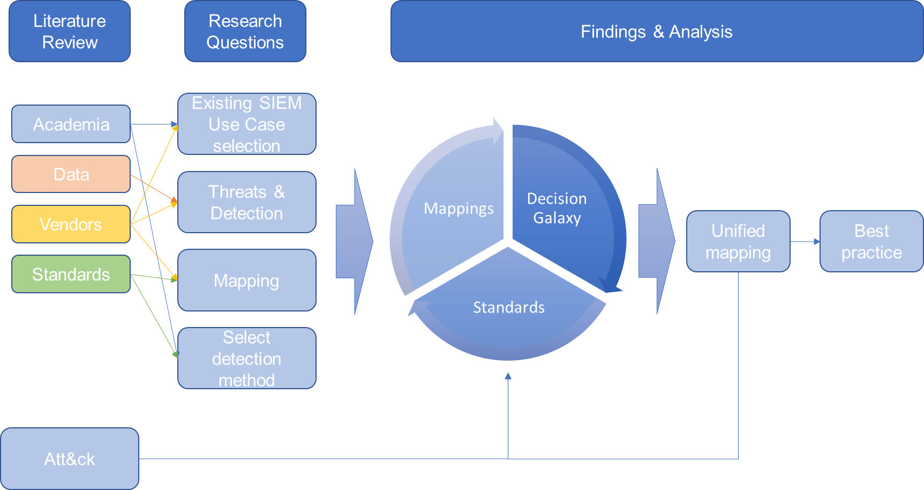
Literature Review – Conceptual Framework
Source: Methodology to select Security Information and Event Management (SIEM) Use Cases - Page 49
Figure 2: Conceptual framework of the thesis
Source: Methodology to select Security Information and Event Management (SIEM) Use Cases - Page 49
Notes:
The extensive research conducted provided valuable insight into existing SIEM Use Case selection methods, available threat data, standards and frameworks. It allows drawing the first conclusions on the continued design of this research. At the centre is the goal to research the best practise method for the SIEM Use Case selection process. If that is combined with the research data of this chapter, then we can conclude in the following framework for the continuous research.

Slide 12
Design & Methodology – Limitations
Source: Methodology to select Security Information and Event Management (SIEM) Use Cases - Page 58
No external influence
SIEM “Use Case”
Att&ck Framework Detection = SIEM Use Case
Detection capability = Use Case
Not measuring effectiveness of SIEM
Data quality of used data
NIST CSF Framework
ML is a Use Case
Application not public
Sample rate of academic writing
Data Privacy
Implementation Cost
Notes:
This paper has used for its research only freely available information. It was not part of the research to let individuals or companies contribute or assist. It potentially could have contributed to achieve better results and to have a better understanding of approaches, recorded data and data quality. In doing so, the focus of this research would have been diluted.
The term “Use Case” is wildly used and the variations of its use in the Cyber Security world include SIEM Use Case, SOC Use Case or Security Incident Response Use Case. This paper will associate “Use Case” for Security Information and Event Management (SIEM).
In this document, we will refer to the detection capabilities as outlined in the Mitre Att&ck framework as SIEM Use Case.
This research assumes that the detection capability can be based on any type of technology. Relevant for this research is that there is a central technical or operational organisation managing the detection or alerts. The technology of centrally managing these alerts is referred to as SIEM in this document. It is essential, however, that this can be any technology and SIEM has been used to adhere to a common understanding. If for example, an organisation has deployed an Intrusion Prevention System (IPS) to detect cyber threats, then this is on par with the referred SIEM.
The author acknowledges that attacks are being run against organisations of all sizes and any number of individuals (The Council on Foreign Relations, 2019) (Hackmageddon, 2019). However, this research does not analyse the effectiveness of current SIEM installations and detection capabilities.
There have been findings of data inconsistencies, but this document does not discuss quality or completeness of any standards or frameworks (for example IKT). The data analysis of the mapping done by 4 different organisations, showed differences in many of the mapped fields. Analysing these differences could potentially be a topic of different research. Mappings can be seen as weak points as the mentioned differences can produce varying results. For that reason, the reader can select the relevant standard for himself and will receive the mapping details as provided by the standard provider.
There is a wide range of established standards and risk management frameworks. The focus of this paper was not to compare the available Frameworks and go through a selection process to select the most suitable. This paper focuses on the NIST CSF as this standard has become relevant within Switzerland for two reasons:
The 2016 revision of the FINMA circular 2008/21 (Borboën, Yan; PwC Switzerland, 2019)
Minimum ICT Standard released by the Federal Office for National Economic Supply (FONES)
The author does not consider SIEM technology based on machine learning as the all solving solution in defining SIEM Use Cases. Machine learning algorithms are still in their infants and deployed solutions need to be trained and must have human supervision. Machine learning can be seen as single types of Use Cases, but it is not seen as the solution an organisation needs to deploy to be secure. At the end of the day, these are products, not concepts protecting the most valuable assets of an organisation.
The resulting application has been written as a fast prototype proof of concept to convey the findings of this research. It was not intended to release to the public as is and would need to be rewritten for that purpose. The author is not a software developer but likes to visualise his ideas.
The data from academia could have been much more comprehensive. Due to the defined scope of this research paper, it was not practical to increase the data corpus for academic literature. By also using, the papers on individual detection technology, there could have been a better sample rate of academic writings.
Data sources can also contain data relevant to privacy laws either impacting employees or customers. Since data sources are an integral part of this research, it is essential to state that data privacy will not be discussed. The purpose of this research shall be to provide a methodology in selecting SIEM Use Cases. The selection process as discussed in this thesis should allow reviewing the results by the responsible person or unit for data privacy.
The research is not taking into consideration the costs accumulated for the selected SIEM Use Cases. When producing a list of recommended SIEM Use cases then that selection is most likely impacting the associated cost. It is out of the boundary of this research to provide any financial figures.

Slide 13
Design & Methodology – Use Case Selection
Source: Methodology to select Security Information and Event Management (SIEM) Use Cases - Page 60
Identify Focus Areas: (1) Van de Moosdijk and Wagenaar, (2) Perniola and Grey and (3) Faircloth
 | (1) | (2) | (3) | Combination
Organisation Requirements | X | X | X | Organisation
Operational Requirements | X |  | X
Compliance |  |  |  | Regulations
Log Management | X |  |  | Detection Capabilities
Correlation | X
Alerting | X |  | X
Response | X
Risk Management |  | X | X | Risk Management
Subject Matter Experts |  | X | X | SMEs
Threats |  |  | X | Threats
Table 2: Combined focus area
Source: Methodology to select Security Information and Event Management (SIEM) Use Cases - Page 60

Slide 14
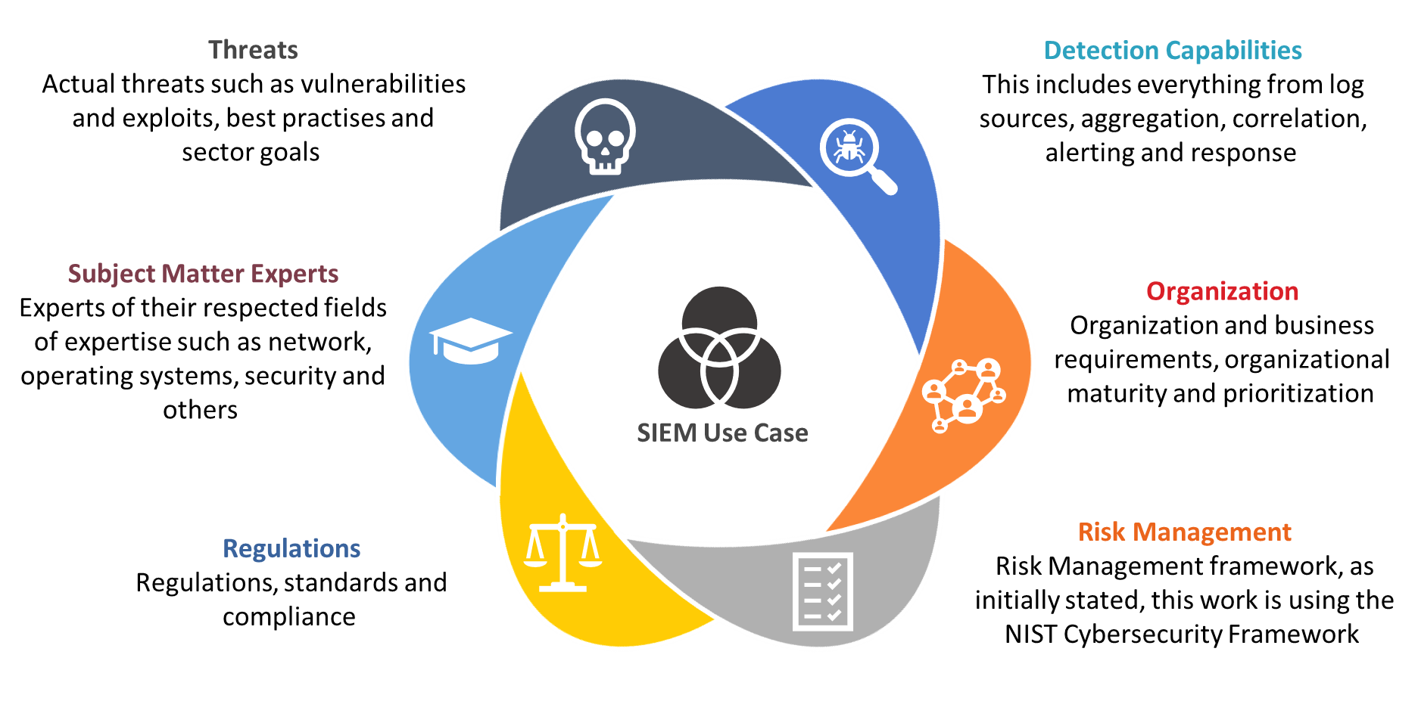
Design & Methodology – Use Case Selection “Decision Galaxy”
Source: Methodology to select Security Information and Event Management (SIEM) Use Cases - Page 61
Figure 14: Use Case decision galaxy
Source: Methodology to select Security Information and Event Management (SIEM) Use Cases - Page 61
Notes:
The combined focus areas are:
Organisation: Organisation and business requirements, organisational maturity, prioritisation
Regulations: regulations, standards, compliance
Detection: This includes everything from log sources, aggregation, correlation, alerting and response
Risk Management: Risk Management framework, as initially stated, this work is using the NIST Cybersecurity Framework
Subject Matter Experts: Experts of their respected fields of expertise such as network, operating systems, security and others
Threats: Actual threats such as vulnerabilities and exploits, best practises and sector goals
By combining these, we can compile a SIEM Use Case decision galaxy.

Slide 15
Design & Methodology – Use Case Selection “Simplification”
Source: Methodology to select Security Information and Event Management (SIEM) Use Cases - Page 72
The focus areas of the SIEM Use Case selection process cover a vast expanse on influencing parameters. The Decision Galaxy can be further simplified by substitution.
Organising Requirements
Costs
Size/Manageability
Optimisation
Focus area | Simplification source
Organisation (4.2.3) | NIST CSF Tiers, CIS CSC Implementation Groups
Regulation (4.2.4) | CIS CSC, NIST CSF, NIST SP 800-53, NERCv7, ISO7IEC 27001, COBIT 5, PCI DSSv3.2, HIPAA and IEC62443
Detection (4.2.5) | Mitre Att&ck Framework
Risk Management (4.2.6) | NIST CSF
Subject Matter Experts (4.2.7) | Mitre Att&ck Framework
Threats (4.2.8) | Mitre Att&ck Framework
Table 2: Focus areas and their simplified sources
Source: Methodology to select Security Information and Event Management (SIEM) Use Cases - Page 72
Notes:
The focus areas of the SIEM Use Case selection process cover a vast expanse on influencing parameters. Each one of them is relevant and needs to be taken into consideration. On the other hand, organisations also need a structured way of weighing their requirements, considering risks and strategy but also need to pay attention to the economic aspects as well as the feasibility of running a potentially extensive cybersecurity programme.
A strategy is needed.
This chapter has covered the various findings for each of the focus areas and has identified sources able to deliver the needed simplifications.
From this research following focus areas and following simplification source have been identified:

Slide 16
Design & Methodology – Use Case Selection “Decision Galaxy”
Source: Methodology to select Security Information and Event Management (SIEM) Use Cases - Page 61
Figure 14: Use Case decision galaxy
Source: Methodology to select Security Information and Event Management (SIEM) Use Cases - Page 61
Notes:
The combined focus areas are:
Organisation: Organisation and business requirements, organisational maturity, prioritisation
Regulations: regulations, standards, compliance
Detection: This includes everything from log sources, aggregation, correlation, alerting and response
Risk Management: Risk Management framework, as initially stated, this work is using the NIST Cybersecurity Framework
Subject Matter Experts: Experts of their respected fields of expertise such as network, operating systems, security and others
Threats: Actual threats such as vulnerabilities and exploits, best practises and sector goals
By combining these, we can compile a SIEM Use Case decision galaxy.

Slide 17
Design & Methodology – Threat Detection
Source: Methodology to select Security Information and Event Management (SIEM) Use Cases - Page 72
The research in chapters 2.2.2 has shown that the Mitre Att&ck Framework has proven to be the most effective dataset available.
Most prolific & advanced cyber attacks
Names of groups
Software used
Techniques
Rule recommendation
Required log sources
Much steeper maturity increase
More likely to be able to identify an attacker
Distinctive gap between the Mitre Att&ck Framework and the business side of or-ganisations.
Include the decision makers
Notes:
The research in chapters 2.2.2 has shown that the Mitre Att&ck Framework has proven to be the most effective dataset available. By studying the most prolific and advanced cybersecurity at-tacks, it was possible to create a database not only with the names of the groups and software used, but also techniques on how to detect these attacks by supplying a rule recommendation and the required log sources for the log events to be recorded in. By selecting specific log sources, an organisation can leverage the various detection capabilities the log source allows to implement. In doing so, the organisation can gain a much steeper maturity increase then by add-ing traditional log sources (Roe, 2019) (Exabeam, 2019). Mainstream cybersecurity vendors are still holding on to traditional log sources (Exabeam, 2019). The real attack data presented by the Mitre Att&ck Framework leads to the conclusion that by focusing on their mentioned data sources, an organisation is more likely to be able to identify an attacker.
There is still a distinctive gap between the Mitre Att&ck Framework and the business side of or-ganisations. The Framework is mainly addressing the technical experts in the field of cybersecu-rity. However, it does not address a vital audience relevant to the decision-making process for cybersecurity programs. The Framework is not addressing the industry related business re-quirements and providing decision makers with a link to existing established processes and frameworks. The reference goes to the various industry standards, frameworks or government requirements such as NIST CSF, ISO/ICE 2700x and COBIT 5. Organisations have invested a significant capita on implementation of these standards and are required to project cybersecurity risks against their relevant framework. The author sees here a great potential to close that gap and to include the decision makers in the Mitre Att&ck Framework.

Slide 18
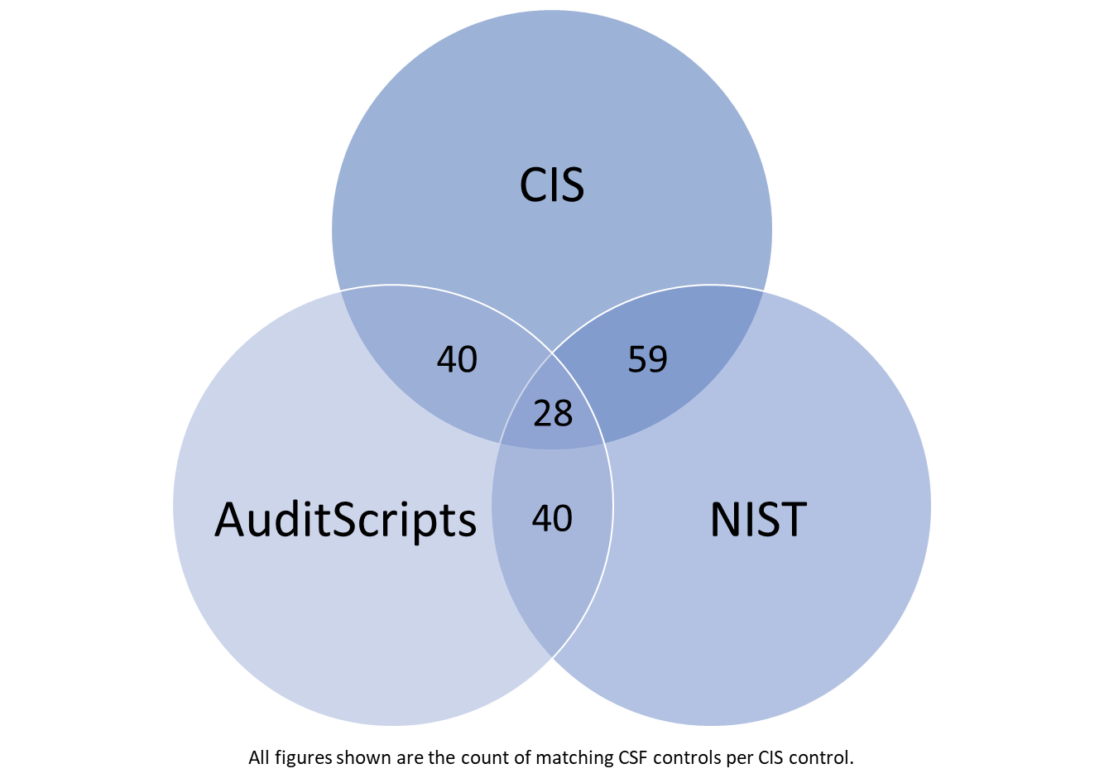
Design & Methodology – Standards Mappings
Source: Methodology to select Security Information and Event Management (SIEM) Use Cases - Page 77
Figure 21: Data comparison of CIS - AuditScripts - NIST mappings to CSC
Source: Methodology to select Security Information and Event Management (SIEM) Use Cases - Page 79
Figure 2: Comparison of mappings to NIST sub-categories
Source: Methodology to select Security Information and Event Management (SIEM) Use Cases - Page 77
Notes:
The identified standards with mapping capabilities are:
NIST CSF Core (NIST, 2019)
Minimal ICT Standard (Minimal ICT Standard, 2019)
CIS Controls v7.1 Mapping for Implementation Groups (CIS, 2019)
AuditScripts (AuditScripts, 2019)
AuditScripts CSC Manual Assessment Tool (AuditScripts, 2019)
CIS Controls v7.1 Mapping to NIST CSF (CIS, 2019)

Slide 19
Design & Methodology – Standards Mappings
Source: Methodology to select Security Information and Event Management (SIEM) Use Cases - Page 77
CIS and NIST have the most overlap
AuditScript mapping seems to be congruent to the other two mappings
Results do not allow for a decisive decision in selecting a mapping file. It rather became apparent, that an organization can select their preferable mapping file.
The organisation simply declares which mapping file has been used.
Any of the mapping files can be used
Notes:
In conclusion, we can see that the CIS and NIST mappings seem to be the most accurate as they are sharing the most mapping entries. There is an indication that the AuditScripts mapping is congruent to the other two standards as they share an equal value of shared mappings.
The data analysed so far does not take into consideration the exact matches of mapped entries. The figures shown are just the overall matching figures on either duplicates or triplicates. It is to assume that when comparing the individual mappings that there we lower number of matches for each compared pair of standards.
The data demonstrate that the results are not allowing a limited selection of a mapping file. However, it became apparent during the analytics that this is not relevant. Organisations can select the needed mapping files. There is no need to have a mapping file from different providers of standards or frameworks. As long as it is declared which mapping file is used, then the organisation has full understanding and transparency. It was a successful exercise to discover that mapping files exist and that the mapped data might not be congruent but that the data shared some common grounds. Possibly useful when developing a method to allow the combination of standards with detection capabilities.

Slide 20
Design & Methodology – Combined Selection Process
Source: Methodology to select Security Information and Event Management (SIEM) Use Cases - Page 86
Continuous improvement lifecycle
Att&ck
Standard
Att&ck and CIS mapping
Figure 2: CIS and Mitre Att&ck mapping file
Source: Methodology to select Security Information and Event Management (SIEM) Use Cases - Page 86
Figure 2: CIS and Mitre Att&ck mapping file
Source: Methodology to select Security Information and Event Management (SIEM) Use Cases - Page 86
Notes:
The Att&ck Framework receives frequent releases, and new data is added about tactics, techniques, groups and software. The data becomes more relevant as new essential facts are being added and can be used to protect any organisation susceptible to the attack method added or changed. Working with the Att&ck Framework and with mapping files to other standards requires a lifecycle process. It must be ensured that the data is continuously synced, implemented sources and detection rules are verified and updated, and most importantly, new threats must be countered by adding new detection methodologies.
Any change can also impact the standard used. Possibly a new control needs to be referenced as well. On the other hand, there are also changes to the used standards, infrastructure or processes, requiring a review of the implemented controls. These also can impact the mapping or the needed and required log sources. The following picture reflects on the symbiosis of how threats and log sources from the Att&ck Framework are intertwined with the standards managing the cybersecurity risks of an organisation.

Slide 21
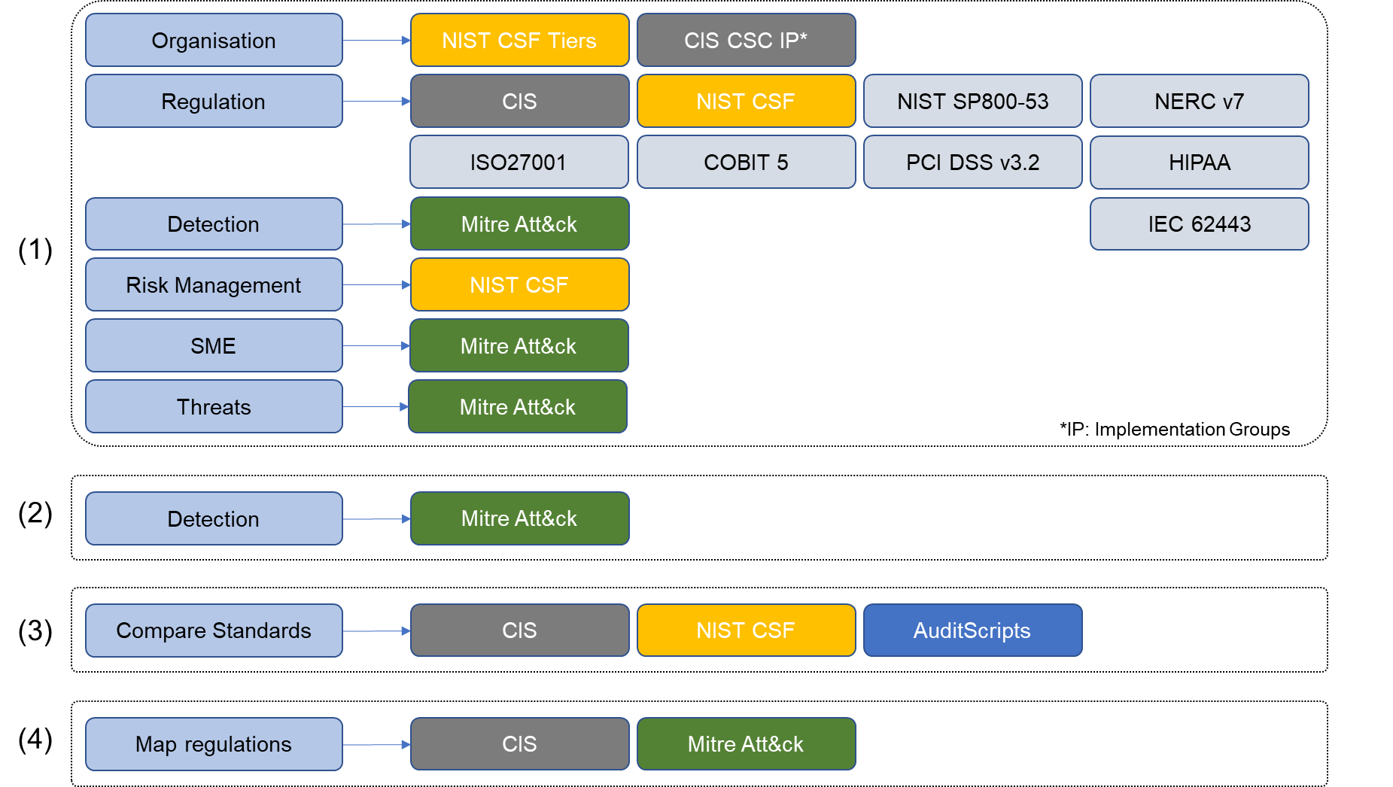
Design & Methodology – Main Research Question
Source: Methodology to select Security Information and Event Management (SIEM) Use Cases - Page 88
Combined findings view
Figure 2: Relationship between all sub-questions
Source: Methodology to select Security Information and Event Management (SIEM) Use Cases - Page 88
Notes:
The first step in trying to answer on how to combine the findings of chapter 4 is to graph the data to get a better understanding. It needs to be understood how the data relates to each other and to find potential relationships.
If we graph the findings, then we get the following picture:
Each focus area out of the first sub-question (1) was associated with a specific standard or framework. In the second sub-question (2) it was established that the most relevant detection methods are available in the Mitre Att&ck Framework. In the third sub-question (3) the trial failed to find a single mapping file. However, the main finding was, that this is not required, and a lookup can be flexible by allowing individual lookups for different standards. The fourth sub-question questioned the possibility to create a mapping file between the Mitre Att&ck Frameworks log sources and the CIS sub-controls. The resulting mapping file allows anyone to select any log source from the Att&ck Framework to receive a list of CIS sub-controls.
The colour coding of the previous graph provides now a visual guide on creating a combined approach. If the Att&ck Framework is centrally hosting all threat information relevant to detecting attackers and is providing to the reader the relevant log sources, following through with the detection, then by mapping these log sources with the CIS controls requirements to collect data and detect threats, there is a bi-directional connection between Att&ck and the CIS controls.
The CIS controls are then related to the other standards via the three different mapping files (yellow, blue and grey in below graph) and thereof the connections to the rest of the standards is done. Moreover, since the CIS sub-controls and the NIST CSF sub-categories have a prioritisation categorisation as discussed in chapter 4.2.3, we can then arrange the results into different groups. These groups we then can call implementation phases, SIEM Use Case priorities or SIEM Use case implementation roadmap.

Slide 22
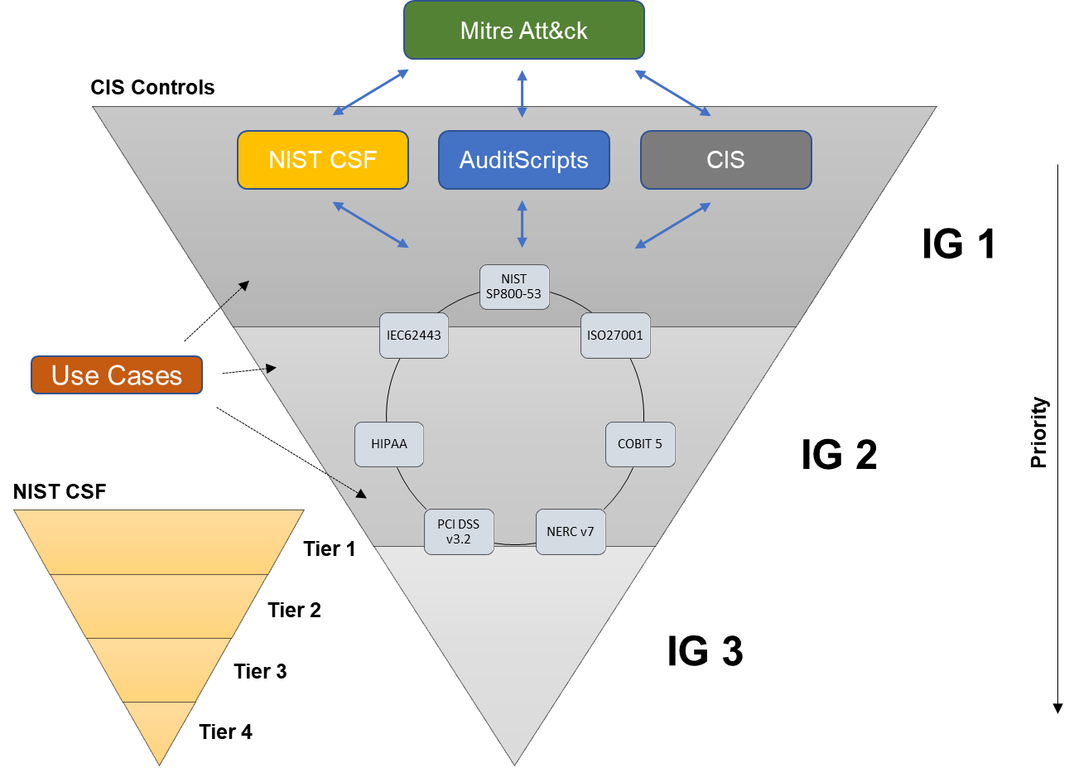
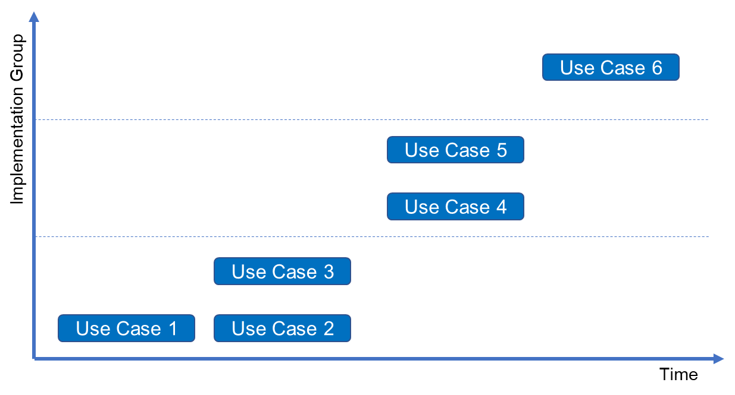
Design & Methodology – Main Research Question
Source: Methodology to select Security Information and Event Management (SIEM) Use Cases - Page 89
Prioritization & maturity
Figure 2: Prioritisation based on framework categorisation of the CIS controls
Source: Methodology to select Security Information and Event Management (SIEM) Use Cases - Page 90
Figure 2: Proposed solution
Source: Methodology to select Security Information and Event Management (SIEM) Use Cases - Page 89
Notes:
The above picture shows the two reverse pyramid shapes. The bigger reverse pyramid is showing the three Implementation Groups of the CIS controls and the smaller reverse pyramid the tiers of the NIST CSF. The idea behind the utilization of these prioritisation categories is to apply these priorities also to the implementation of the SIEM Use Cases. Any number of identified SIEM Use Cases will have implementation priorities assigned due to the association with the CIS controls or the NIST CSF categories.
The result of applying this technique is a roadmap of the SIEM Use Cases to implement according to prioritisation as shown in the next graph.
The application of the framework categorisation allows to plan the implementation of the SIEM Use Cases and as such guides as outlined in the problem statement. However, it is not possible to have prioritisation within an implementation group or a tier. The prioritisation inside an implementation group or a tier can be defined within the project based on the availability of resources and implementation time. This model does not provide further guidance to break down prioritisation further.

Slide 23
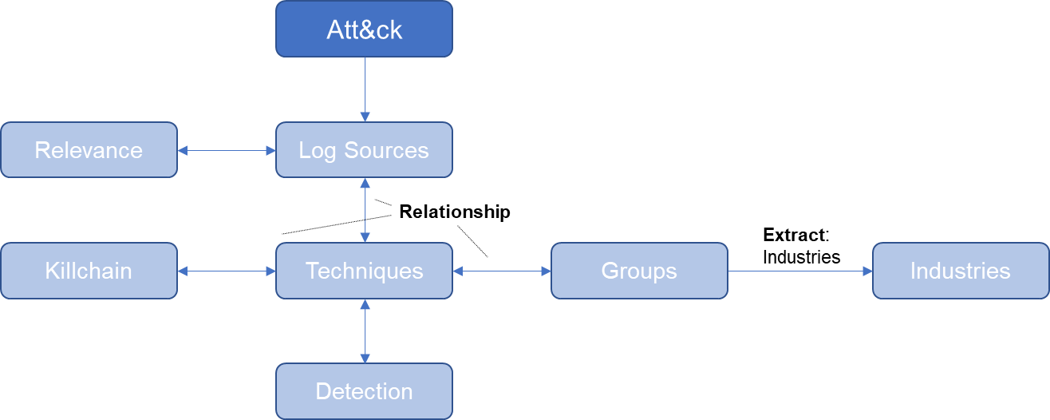
Design & Methodology – Main Research Question
Source: Methodology to select Security Information and Event Management (SIEM) Use Cases - Page 91
Att&ck Framework features
Figure 2: Att&ck data relevant for the mapping
Source: Methodology to select Security Information and Event Management (SIEM) Use Cases - Page 91
Notes:
The logical next step is to transport the initial mapping idea into a working model. At the centre is the Att&ck Framework. Chapter 2.2.2.4 holds a short introduction on the framework and about the data available. The focus now resides on the log sources, techniques, kill-chain, groups and the industries. Apart from the industries references the framework provides these data points in a normalised form (Mitre, 2019) and can be extracted as described in chapter 3.5.2.
As shown in the above graph, the log sources have a bi-directional link to the techniques and the relevance. The relevance stands for the SMEs and indicates the log sources with the most detection capabilities. The techniques, on the other hand, connect to the detection, kill-chain and the groups bidirectionally. The industry information is extracted manually from the Att&ck group information and for that reason are only directly linked to the groups.
The central component of the final mapping solution is the glue between the Att&ck Framework and CIS. The mentioned glue is a mapping file listing all Att&ck log sources and entries of all matching CIS sub-controls as described in chapter 4.5.2.

Slide 24
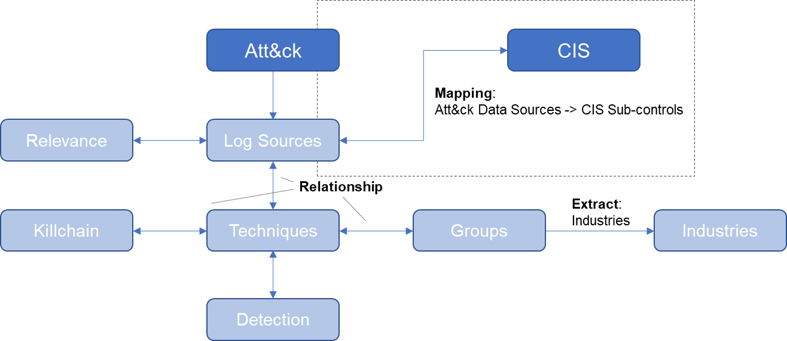
Design & Methodology – Main Research Question
Source: Methodology to select Security Information and Event Management (SIEM) Use Cases - Page 91
Mapping between CIS & Att&ck
Figure 2: Mapping between Att&ck log sources and CIS sub-controls
Source: Methodology to select Security Information and Event Management (SIEM) Use Cases - Page 91
Notes:
After having established the connection between the Att&ck Framework and the CIS controls it is possible to connect the three mapping files from CIS, NIST CSF and AuditScripts. Each of the three mapping files contains entries with matching CIS controls.

Slide 25
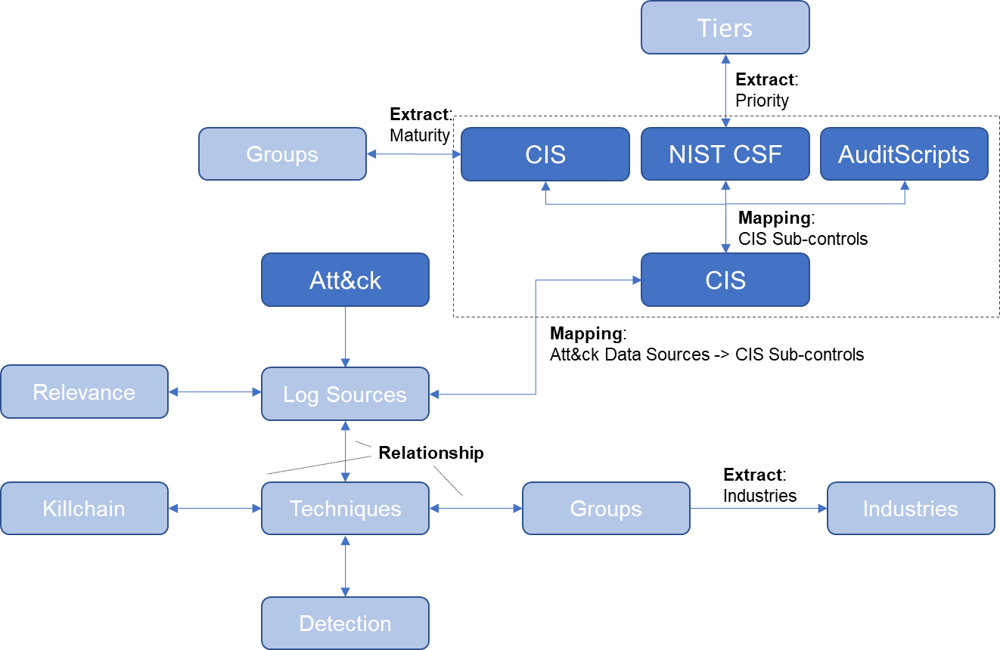
Design & Methodology – Main Research Question
Source: Methodology to select Security Information and Event Management (SIEM) Use Cases - Page 92
Prioritisation & Maturity
Figure 2: Mapping of CIS sub-controls to the individual mapping files
Source: Methodology to select Security Information and Event Management (SIEM) Use Cases - Page 92
Notes:
The above graph also shows the prioritisation categories for the implementation groups provided by CIS and the Tiers as provided by NIST CSF.

Slide 26
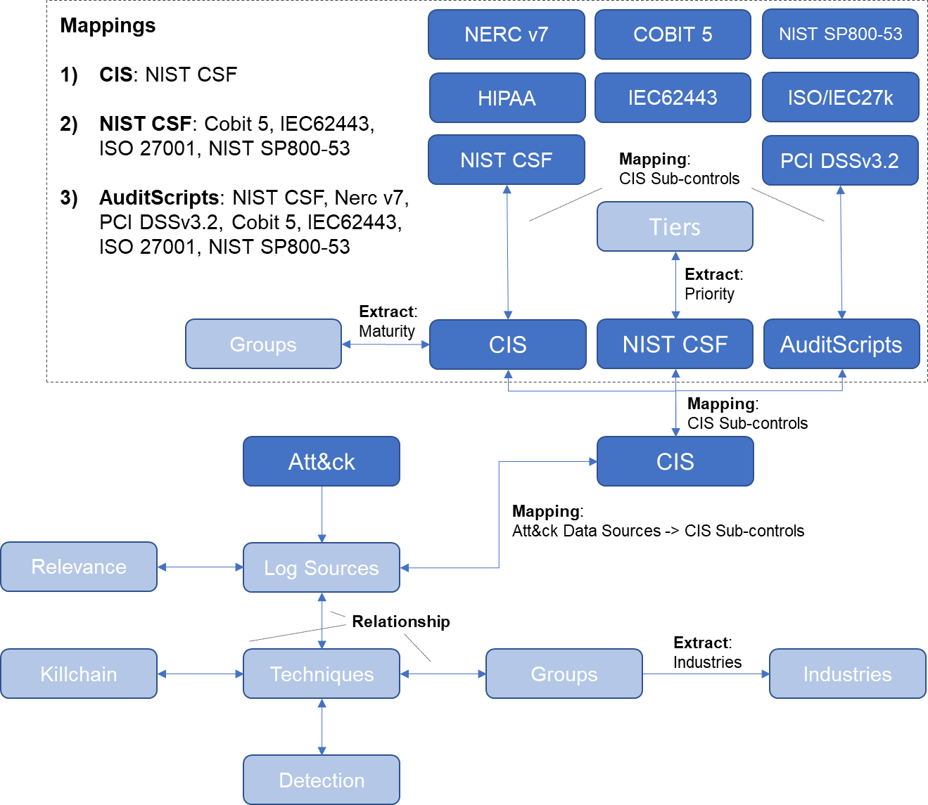
Design & Methodology – Main Research Question
Source: Methodology to select Security Information and Event Management (SIEM) Use Cases - Page 93
Final mapping content
Figure 2: Mapping overview of all data sets
Source: Methodology to select Security Information and Event Management (SIEM) Use Cases - Page 93
Notes:
The last step is the inclusion of the content of the mapping files. The CIS mapping file will provide a mapping to the NIST CSF. The NIST CSF mapping file will provide mappings to Cobit 5, IEC 62443, ISO 27001 and NIST SP800-53. Lastly, the AuditScript mapping file provides mappings to NIST CSF, Nerc v7, PCI DSS v3.2, Cobit 5, IEC 62443, ISO 27001 and NIST SP800-53.
The data produced by combining the Att&ck Framework and all the standards is an extensive list of detections. We have established in chapter 3.8 that detections are referred to as SIEM Use Cases. What is missing is a method of assistance to make the extensive list of Use Cases selectable via the focus areas discussed in chapter 4.2.2. The bi-directional links as shown are providing these filters and selectors. The following picture contains possible selectors and filters.

Slide 27
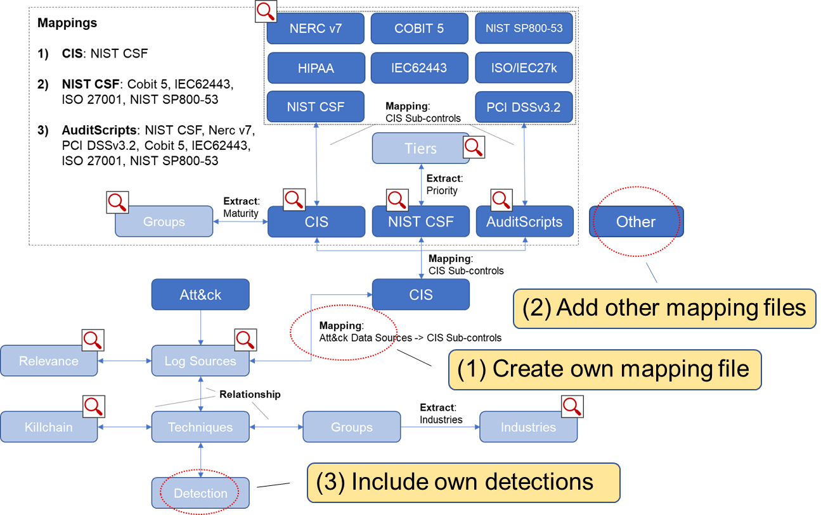
Design & Methodology – Main Research Question
Source: Methodology to select Security Information and Event Management (SIEM) Use Cases - Page 95
Filters & Improvements
Figure 2: Ease of adjustment of the method
Source: Methodology to select Security Information and Event Management (SIEM) Use Cases - Page 95
Notes:
The meaning of filters in this context is to provide drill-down capabilities. Selectors, on the other hand, can be used to build up a meaningful SIEM Use Case selection.
As previously discussed, the method can easily be extended depending on the specific requirements. The next picture is highlighting the objects and places where the extension can occur. If for example the mapping between Att&ck and CIS (1) needs small adjustments or need to be changed due to new data, then that mapping file can be replaced. The same is valid also for the mapping standards (2). If a standard is not included, then a mapping file including that standard is included. Lastly, organisations might have very distinct detection needs (3) not covered in the Att&ck Framework. These can be added by mapping them to the relevant log sources or techniques.

Slide 28
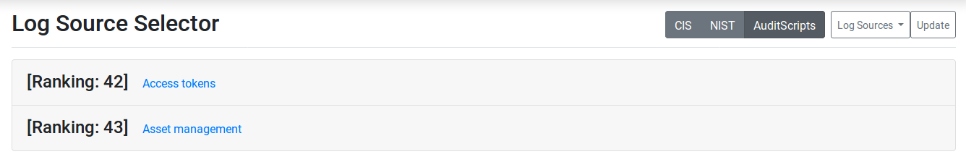
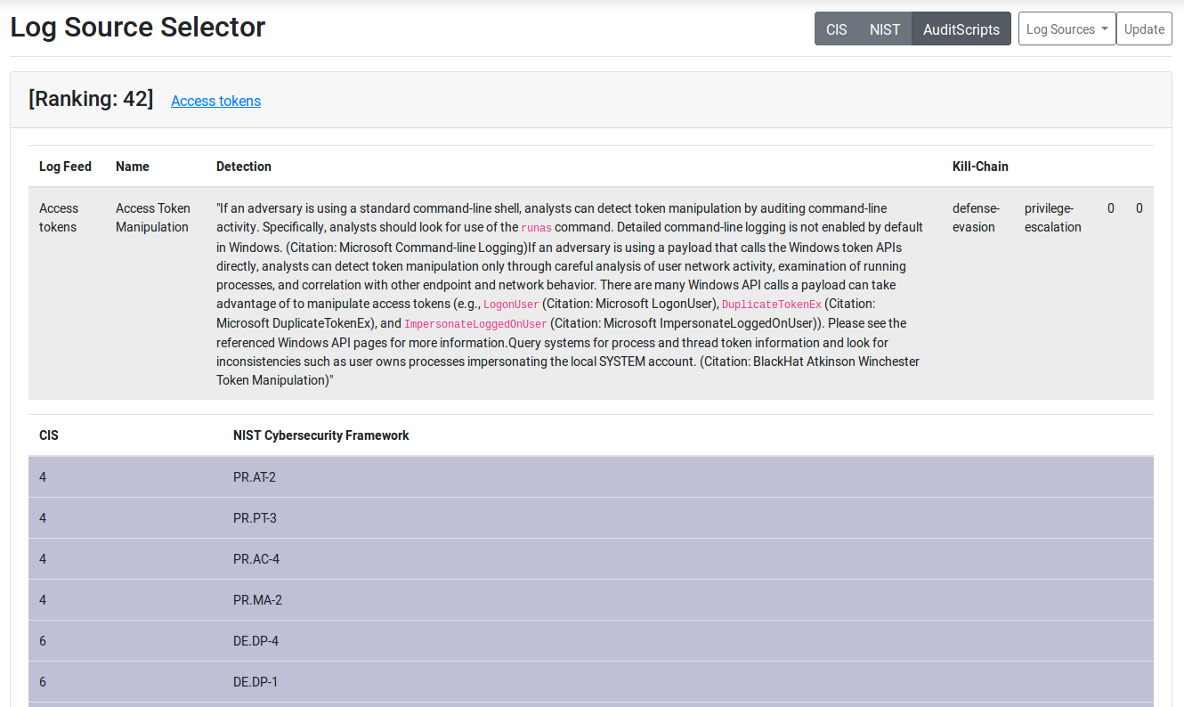
Design & Methodology – Proof of Concept
Source: Methodology to select Security Information and Event Management (SIEM) Use Cases - Page 96
Figure 35: Log source collector and mapping selector
Source: Methodology to select Security Information and Event Management (SIEM) Use Cases - Page 96
Selecting log sources:
Technique
Detection capabilities
Killchain
CIS mapping
NIST CSF mapping
Figure 36: Detection method and associated NIST CSF sub-controls
Source: Methodology to select Security Information and Event Management (SIEM) Use Cases - Page 97

Slide 29
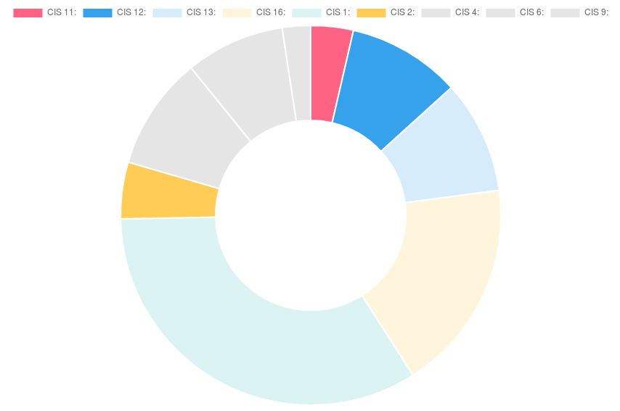
Design & Methodology – Proof of Concept
Source: Methodology to select Security Information and Event Management (SIEM) Use Cases - Page 99
Figure 2: CIS control doughnut chart
Source: Methodology to select Security Information and Event Management (SIEM) Use Cases - Page 99
Notes:
This chapter was discussing the creation of a mapping file (4.6.1) between the log sources from the Mitre Att&ck Framework and the CIS sub-controls. The resulting mapping file is controlling the resulting link between the Att&ck Framework and the individual standard mappings. It is not the claim of this research that the produced Att&ck and CIS mapping is without errors. That is not necessary. It was to show that with a mapping file there is a possible methodology for a best practises approach for the SIEM Use Case selection process.

Slide 30
Analysis & Synthesis
Source: Methodology to select Security Information and Event Management (SIEM) Use Cases - Page 100
SIEM Use Case Selection
Threats & Detection
Standards
The argument was to find quantitative replacements for the focus areas able to formulate a methodology on how SIEM Use Cases can be selected. The results thereof are direct relationships between the focus areas and standards and frameworks. With this approach, we can select Use Cases based on frameworks and standards.
The research in chapters 2.2.2 has shown that the Mitre Att&ck Framework has proven to be the most effective dataset available.
If there is a declaration of which mapping file is used, then any of the mapping files can be used. It is the same approach as if an organisation defines a standard for their organisation to follow.
Notes:
SIEM Use Case Selection
The argument was to find quantitative replacements for the focus areas able to formulate a methodology on how SIEM Use Cases can be selected. The results thereof are direct relationships between the focus areas and standards and frameworks. With this approach, we can select Use Cases based on frameworks and standards.
Threats & Detection
The research in chapters 2.2.2 has shown that the Mitre Att&ck Framework has proven to be the most effective dataset available.
Standards
If there is a declaration of which mapping file is used, then any of the mapping files can be used. It is the same approach as if an organisation defines a standard for their organisation to follow. It was a successful exercise to discover that mapping files exist and that the mapped data might not be congruent but that the data shared a more significant portion of its map-pings.

Slide 31
Analysis & Synthesis
Source: Methodology to select Security Information and Event Management (SIEM) Use Cases - Page 102
Selection
Main Research Question
It has been shown in chapter 4.5.2 that such a mapping can be created. The mapping of Att&ck and CIS is done by matching the content of each source logically by terminology. For the remainder with ambiguity or with no direct linkage to sensor technology, the whole framework description and the attack data set had to be compared against each other.
This research has shown that it is possible to have a unified approach in using SIEM Use Case focus areas necessary for their selection and combine them with the relevant cybersecurity standards and frameworks. The result is a flexible best practises solution allowing for various parameters to be configured to receive a list of applicable SIEM Use Cases.
Notes:
Selection
It has been shown in chapter 4.5.2 that such a mapping can be created. The mapping of Att&ck and CIS is done by matching the content of each source logically by terminology. For the remainder with ambiguity or with no direct linkage to sensor technology, the whole framework description and the attack data set had to be compared against each other.
Main Research Question
This research has shown that it is possible to have a unified approach in using SIEM Use Case focus areas necessary for their selection and combine them with the relevant cyber-security standards and frameworks. The result is a flexible best practises solution allow-ing for various parameters to be configured to receive a list of applicable SIEM Use Cases.

Slide 32
Conclusion
Source: Methodology to select Security Information and Event Management (SIEM) Use Cases - Page 103
The research has shown that it is possible to have a unified approach in using SIEM Use Case focus areas necessary for their selection and combine them with the relevant cybersecurity standards and frameworks.
The result is a flexible methodology allowing for various parameters to be configured to receive a list of applicable SIEM Use Cases.
With moving the detection capability of an organisation back into the focus, we can break down the goals based on the data gathered.
None of the existing parameters was subdued or marginalised with this approach, and it still can be added if required.
At the centre is still a robust cybersecurity program driving the organisational needs, but it will be supported with qualified data from a relevant threat source able to assist in formulating a roadmap of rolling out detection capabilities.
It answers the questions of what is needed to be able to detect the cybersecurity threats trageting the organisation.
Notes:
The research has shown that it is possible to have a unified approach in using SIEM Use Case focus areas necessary for their selection and combine them with the relevant cybersecurity standards and frameworks. The result is a flexible methodology allowing for various parameters to be configured to receive a list of applicable SIEM Use Cases. With moving the detection capability of an organisation back into the focus, we can break down the goals based on the data gathered. None of the existing parameters was subdued or marginalised with this approach, and it still can be added if required. At the centre is still a robust cybersecurity program driving the organisational needs, but it will be supported with qualified data from a relevant threat source able to assist in formulating a roadmap of rolling out detection capabilities. It answers the questions of what is needed to be able to detect the threats against the organisation.

Slide 33
Flexibility of the method
Source: Methodology to select Security Information and Event Management (SIEM) Use Cases - Page 103
Method
Focus area selection
Interchangeable mappings
Filters
Selectors
Extendable
The presented method is very diverse and highly flexible model to select SIEM Use Cases.
Notes:
The model is highly flexible as shown in chapter 4.6.1
Not only does the method provide a workable solution on how to select SIEM Use Cases according to existing focus areas but it also is possible to that the mapping files are interchangeable.
The bi-directional links as introduced in chapter 4.6.1 are providing filters and selectors. The meaning of filters in this context is to provide drill-down capabilities.
Selectors, on the other hand, can be used to build up a meaningful SIEM Use Case selection.
As previously mentioned, the method can easily be extended depending on the specific requirements. The extensions can be done on the primary mapping between Att&ck and CIS, on the mapping standards and the detection capability.

Slide 34
Further Research
More Use Cases
Incorporation of other SIEM Use Case resources such as SIGMA[1] or SOCPrime[2]. A guide could be provided also to include self-developed SIEM Use Cases and how to map them to the Att&ck Framework.
Public Portal
Further development of the application to upload risk assessment results of one of the supported frameworks and then provide an overview of which SIEM Use cases to deploy in which prioritisation, the required log sources, the association to the other standards and the statistical overview of CIS, kill-chain and NIST CSF functions.
1. Att&ck Framework enhancement
Reach out to Mitre for a suggestion to include business-relevant information such as discussed in chapter 4.3. Increasing the reach of the Framework in order to protect organisations must be a goal of every cybersecurity practitioner.
2. Att&ck Framework enhancement
Reach out to Mitre to suggest the mapping to CIS. The impact of a precise mapping is much more significant than done by an individual. If the mapping can help to drive the adoption rate, then it is a win for all.
Source: Methodology to select Security Information and Event Management (SIEM) Use Cases - Page 103
[1] https://github.com/Neo23x0/sigma
[2] https://my.socprime.com/en/tdm/
Notes:
The author sees potential in pursuing further research in the areas of:
Incorporation of other SIEM Use Case resources such as SIGMA or SOCPrime. A guide could be provided also to include self-developed SIEM Use Cases and how to map them to the Att&ck Framework.
Further development of the application to upload risk assessment results of one of the supported frameworks and then provide an overview of which SIEM Use cases to deploy in which prioritisation, the required log sources, the association to the other standards and the statistical overview of CIS, kill-chain and NIST CSF functions.
Reach out to Mitre for a suggestion to include business-relevant information such as discussed in chapter 4.3. Increasing the reach of the Framework in order to protect organisations must be a goal of every cybersecurity practitioner. Conclusions and Recommendations Lucerne University of Applied Sciences and Arts 104/135
Reach out to Mitre to suggest the mapping to CIS. The impact of a precise mapping is much more significant than done by an individual. If the mapping can help to drive the adoption rate, then it is a win for all.

Slide 35
Thank you!

Slide 36
References
All content within this presentation are extracts of the thesis “Methodology to select Security Information and Event Management (SIEM) Use Cases”.

Slide 37
SIEM Use Case Questions
We have following log sources. Which SIEM Use Cases should we implement?
Example output: By Industry, by relevance, by standard, implementation roadmap (maturity)
We are an X sized organization. Which SIEM Use Cases should we implement?
Example output: By industry, by log sources, by relevance, implementation roadmap (maturity)
Which are the top 5 SIEM Use Cases?
Example output: By industry, by maturity, by standards, by log sources, by tactic

Slide 38
SIEM Use Case Questions
We have to comply to standard X. Which SIEM Use Cases should we implement?
Example output: By Industry, by relevance, by log sources, implementation roadmap (maturity)
We operate in the industry sector X. Which SIEM Use Cases should we implement?
Example output: By log sources, by standard, by relevance, implementation roadmap (maturity)
We have following SIEM Use Cases. What coverage does this give us?
Example output: By industry, by maturity, by standards, by log sources, by tactic, by maturity

